Slide 1
Bifurcation Theory, Recursion, and the Mandelbrot Set
Alessandro Bressani

Slide 2

$$x_{n+1}=rx_{n}({1−x}_{n})$$
Notes:
Has anyone seen this equation before?
Standard recursive formula (“logistics map”)
X goes from zero to one
R is the rate of change
Treat like population model

Slide 3
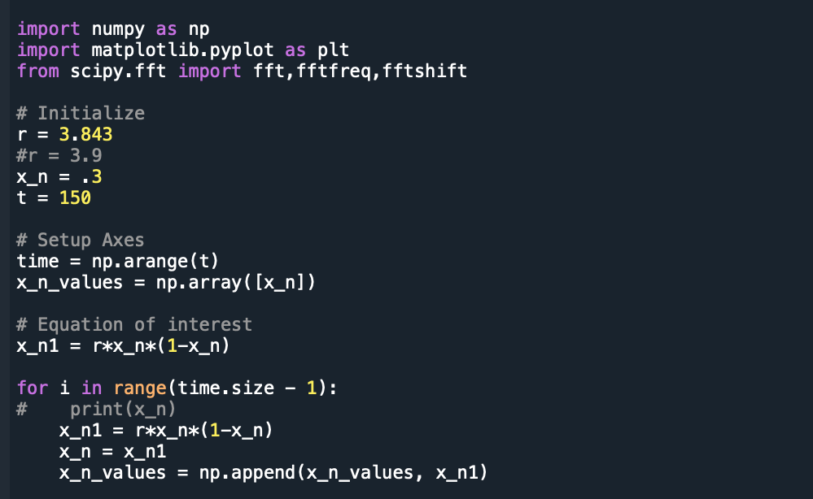
Code
Notes:
Very simple
Choose r and x_n
Ran multiple times

Slide 4
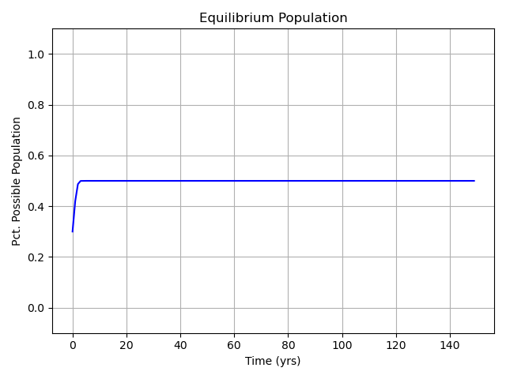
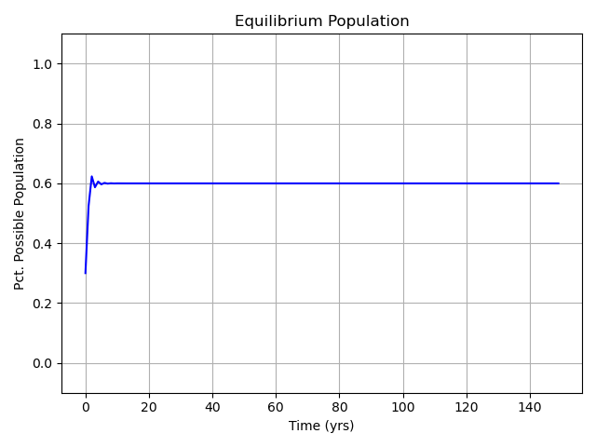

$$x_{n+1}=rx_{n}({1−x}_{n})$$
Initial x = 0.3
r = 2
Initial x = 0.3
r = 2.5
Notes:
Plot x values after each recursion
We only get one equilibrium position

Slide 5
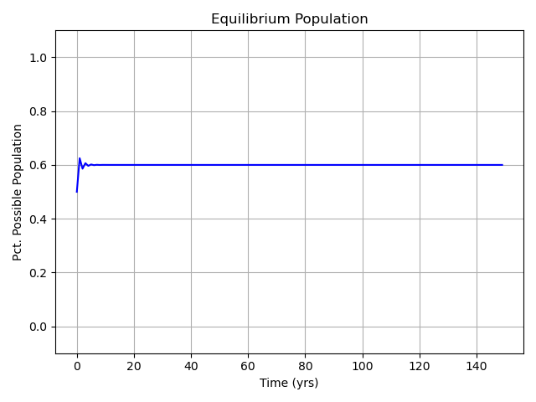
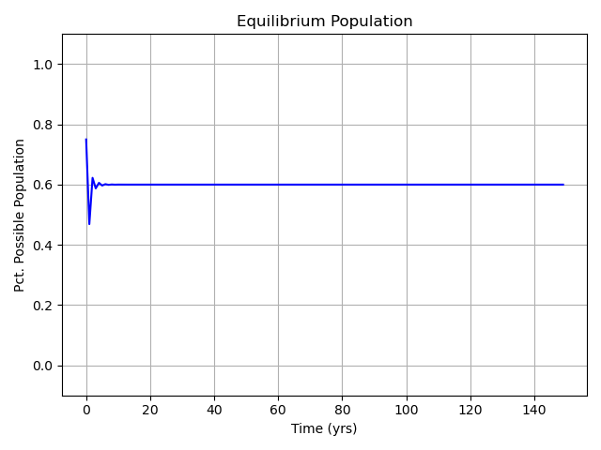

$$x_{n+1}=rx_{n}({1−x}_{n})$$
Changing Initial x
Initial x = 0.5 Eq. Pos: 1
r = 2.5
Initial x = 0.75 Eq. Pos: 1
r = 2.5
Notes:
Our equilibrium position is not dependent on initial x condition
Only r changes equilibrium position
What if we keep raising r?

Slide 6
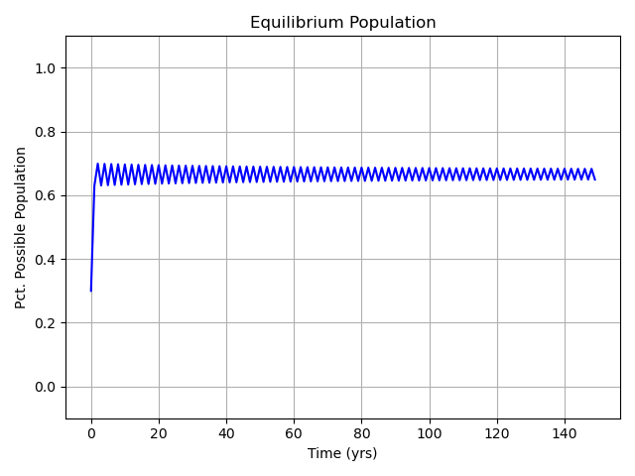
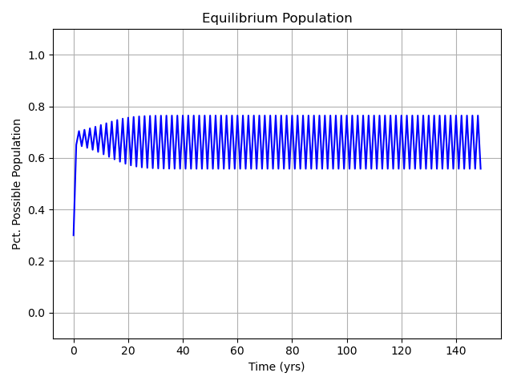
$$x_{n+1}=rx_{n}({1−x}_{n})$$
Increasing r
Initial x = 0.3 Eq. Pos: 2
r = 3
Initial x = 0.3 Eq. Pos: 2
r = 3.1
Notes:
Raising r leads to more equilibrium position and more spacing between eq positions

Slide 7
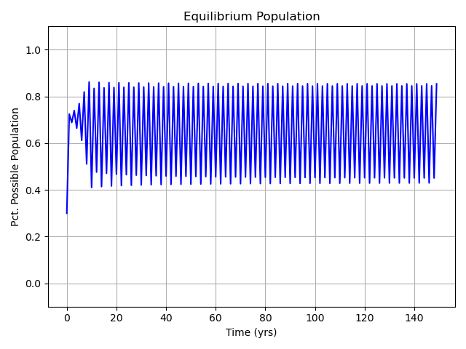
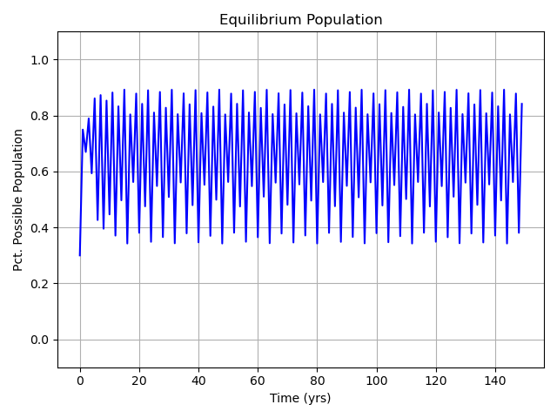
$$x_{n+1}=rx_{n}({1−x}_{n})$$
Increasing r
Initial x = 0.3 Eq. Pos: 4
r = 3.5
Initial x = 0.3 Eq. Pos: 8
r = 3.57
Notes:
Higher r leads to more equilibrium positions

Slide 8
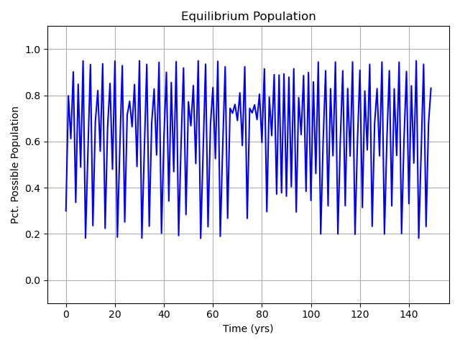
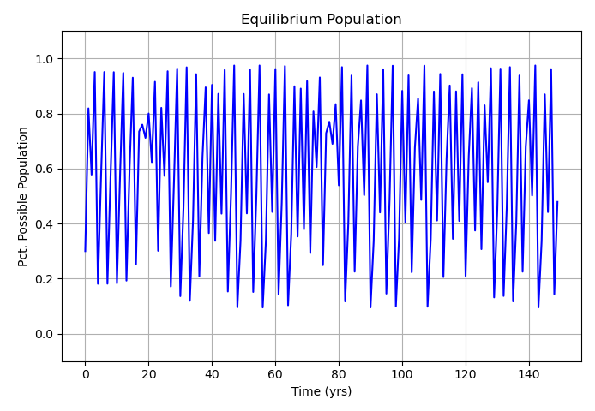
$$x_{n+1}=rx_{n}({1−x}_{n})$$
Aperiodic behavior past r ~ 3.6
Initial x = 0.3
r = 3.8
Initial x = 0.3
r = 3.9
Notes:
Higher r leads to more equilibrium positions
More chaotic behavior

Slide 9
What happens when we plot equilibrium position vs R?

Slide 10
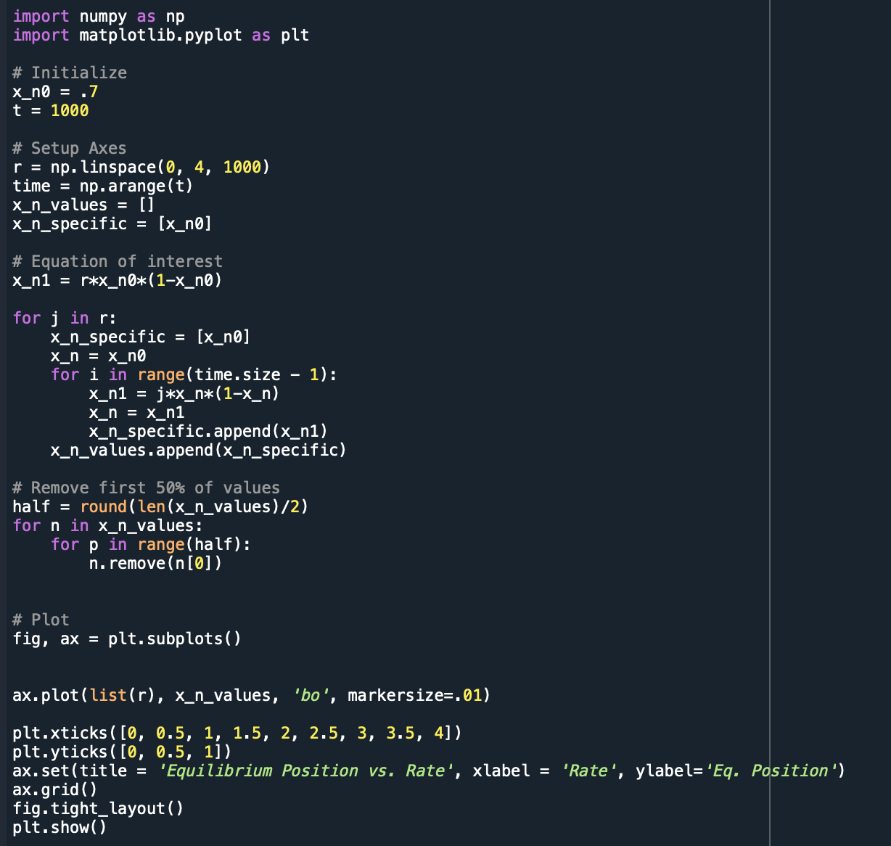
code
Notes:
Modify original
Set r on x axis, remove first 50% of values to find eq positions

Slide 11
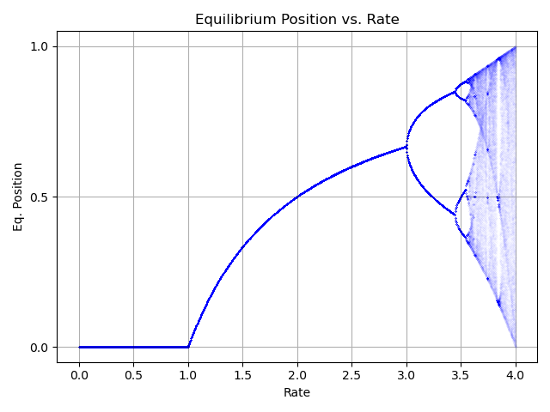
Equilibrium Position vs R
Notes:
We can see how 2 eq positions appear around 3, 4 appear around 3.45, 8 appear around 3.57, and so on
4 is the max, as once x hits one or zero, the equation nullifies
These are defined as bifurcations
Each previous bifurcation is 4.669 times the length of the current bifurcation
4.669 is the Feigenbaum constant
Fundamental constant of nature

Slide 12
R = 3.843
Notes:
Interesting case at r = 3.843
Momentary stability

Slide 13
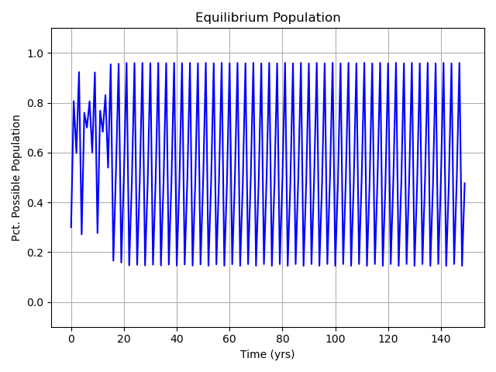
R = 3.843
Notes:
2 eq positions

Slide 14
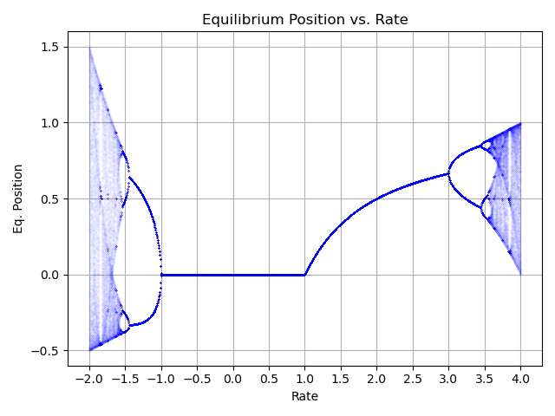
Order to Chaos
Notes:
r can be negative
Negative when a system switches to a new behavior with half the period of the original system
Period halving bifurcation leads to order, period doubling bifurcation leads to chaos

Slide 15

Mandelbrot Set
$$x_{n+1}=x_{n}^{2}+c$$
Notes:
New recursive equation of interest
C is any number on the complex plane
A number is part of the set if the recursion does not lead to infinity/ negative infinity

Slide 16
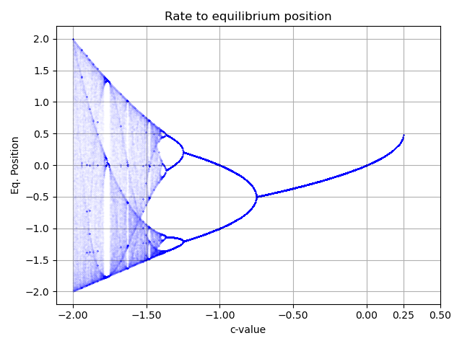
Real numbers vs. equilibrium position
Notes:
Same bifurcation patterns appear with same Feigenbaum constant

Slide 17
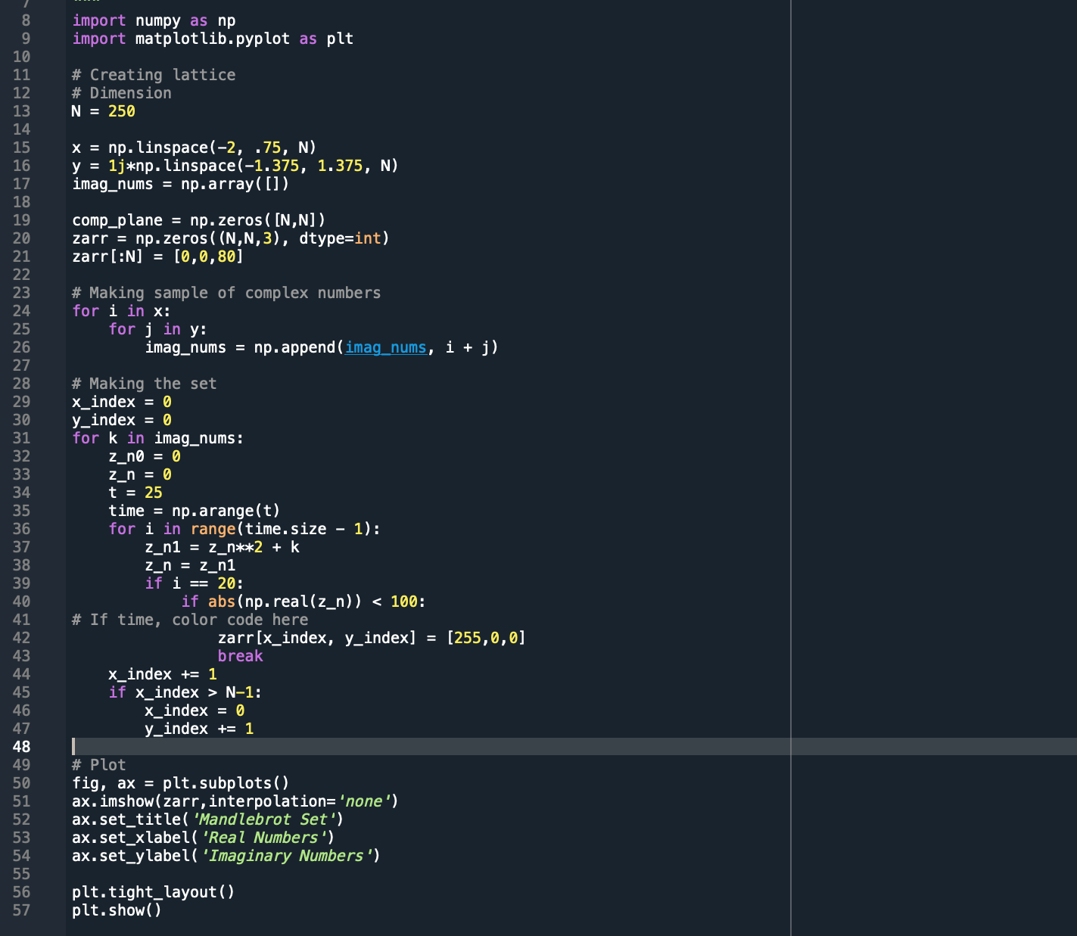
Making the Set
Notes:
Created complex plane
Used lattice code from class
Assigned each pixel to a complex number
Few iterations needed for equation to blow up
Check if real part of number is too large
If number does not blow up, change assigned pixel color

Slide 18
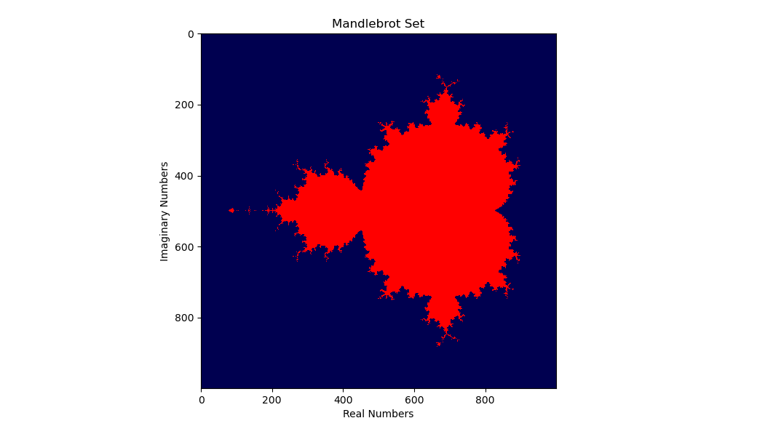
Mandelbrot Set
Notes:
1000x1000 pixels
X axis from -2 to 0.75
Y axis from -1.375 to 1.375

Slide 19
Bubbles correspond to number of Equilibrium positions
2
4
2
1
2

Slide 20
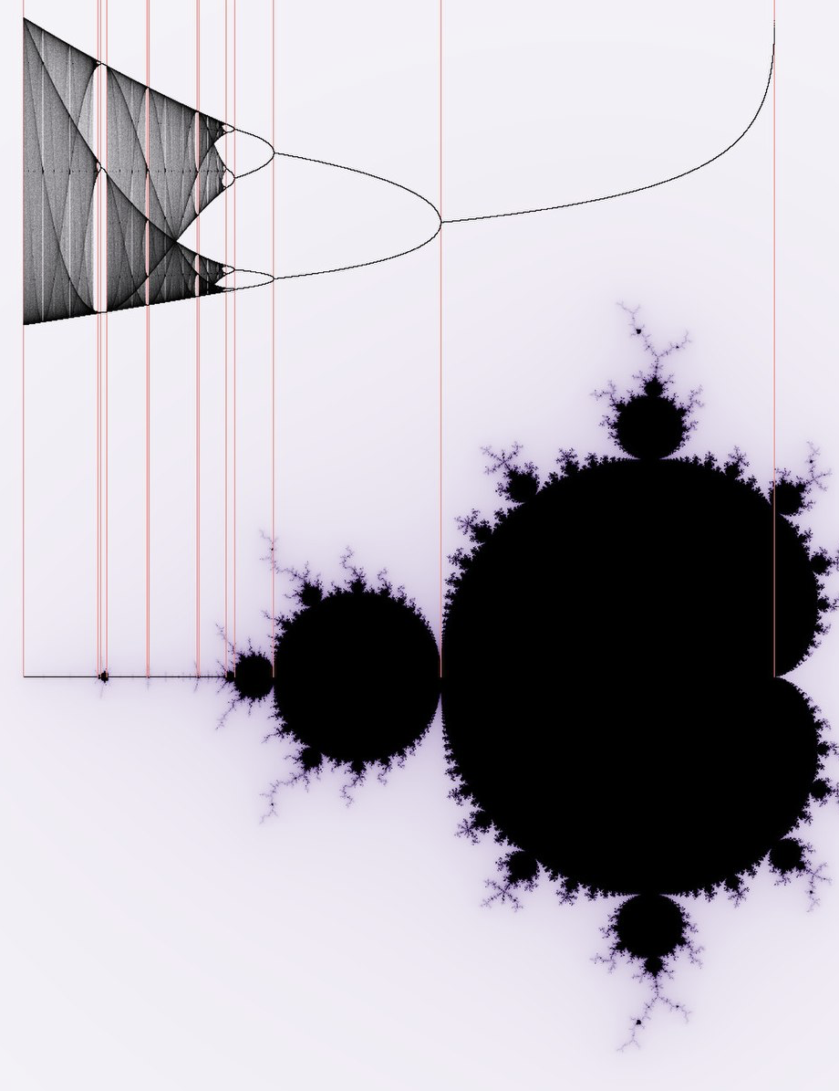
Comparing equilibrium position to Mandelbrot set

Slide 21
Applications
Found in nature
Types of Bifurcation
Population dynamics
Epidemiology
Convective rolls
Introduction to chaos
Water dripping from a faucet
Local
Saddle-node
Transciritcal
Pitchfork
Hopf
Global
Homoclinic
Heteroclinic
Infinite period
Notes:
Bifurcation theory can be applied to all of these
Any small parameter change can lead to vastly different conclusion

Slide 22
REFERENCES
Alligood, Kathleen T.; Sauer, Tim; Yorke, James (1996). Chaos: An Introduction to Dynamical Systems.
Kalogirou, A.; Keaveny, E. E.; Papageorgiou, D. T. (2015). "An in-depth numerical study of the two-dimensional Kuramoto–Sivashinsky equation".
May, R. Simple mathematical models with very complicated dynamics. Nature 261, 459–467 (1976).
R. M. May, D. M. G. Wishart, J. Bray and R. L. Smith Chaos and the Dynamics of Biological Populations Source: Proceedings of the Royal Society of London. Series A, Mathematical and Physical Sciences, Vol. 413, No. 1844, Dynamical Chaos (Sep. 8, 1987), pp. 27-44.
Libchaber, A. & Laroche, C. & Fauve, Stephan. (1982). Period doubling cascade in mercury, a quantitative measurement.

Slide 23
Questions?

